Slide 1
By Vendra Durga Prasad 213079014
1
Dual clock FIFO

Slide 2

FIFO is like a queue:
25
Next Empty Slot
in the queue.
(Tail of the queue)
Senior-most person in
the queue
Similar to WP
7
6
5
4
3
2
1
0
FILLED
FILLED
FILLED
FILLED
FILLED
(Head of the queue)
WP
Similar
to RP
RP

Slide 3
FIFO PIN-OUT
26
WEN
Write Enable (from the Producer)
REN
Read Enable (from the Consumer)
FULL
Full status info (to the Producer)
EMPTY
Empty status (to the Consumer)
WD (WRITE DATA)
RD (READ DATA)
FIFO
AF (ALMOST FULL)
AF status info (to the Producer)
(Optional)
AE (ALMOST EMPTY)
AE status info (to the Consumer)
(Optional)
CLK

Slide 4
FIFO Block Diagram
27
WEN
Write Enable (from the Producer)
REN
Read Enable (from the Consumer)
FULL
Full status info (to the Producer)
EMPTY
Empty status (to the Consumer)
WD (WRITE DATA)
RD (READ DATA)
FIFO
WP
RP
AF (ALMOST FULL)
AF status info (to the Producer)
(Optional)
AE (ALMOST EMPTY)
AE status info (to the Consumer)
(Optional)
Wr_CLK
Rd_CLK

Slide 5
Producer
2
Consumer
Producer
Consumer
1-location Buffer
Producer
Consumer
FIFO

Slide 6
FIFO
4
Delinks the producer and the
consumer
PRODUCER
Writer
Deposits Data into the FIFO.
CONSUMER
Reader
Reads Data from the FIFO.

Slide 7
Let us use an 8-location FIFO for our design example
7
7
6
5
4
3
2
1
0
PRODUCER
CONSUMER
WP RP
Initially
The FIFO has two pointers to denote the locations to write and read:
Write Pointer (WP): The location pointed to by the WP is where producer deposits data.
Read Pointer (RP): The location pointed to by the RP is from where consumer reads data.
Initially the FIFO is empty. Both WP and RP point to location 0 of the FIFO.

Slide 8

Points to the location to be written
14
FILLED
FILLED
FILLED
FILLED
7
6
5
4
3
2
1
0
WP
CONSUMER
PRODUCER
RP
Points to the location
to be read

Slide 9

17
WP
7
6
5
4
3
2
1
0
FILLED
FILLED
FILLED
FILLED
FILLED
CONSUMER
PRODUCER
RP
Now if we write to location 7, should the WP be incremented and be allowed to point to location 0?

Slide 10
FIFO Storage
Register Array acting as a Dual Port Memory
30
(a write-only (WO) port and a read-only (RO) port)
WA
RA
WA2
WA2
DUAL PORT RAM
WA1 MEMORY
WA0
RA2 RA1 RA0
RA2
WA1
RA1
WA0
RA0
WENQ
RENQ
WEN
REN
WD3
WD3 WD2 WD1 WD0
8x4
RD3 RD2 RD1 RD0
RD3
WD2
RD2
WD1
RD1
WD0
RD0
CLK
WD
RD

Slide 11




WP and RP pointers – when to increment them
31
WP RP
FULL
EMPTY
RENQ
WEN
WENQ
REN
WP
EN
RP
EN
QA
QB QC
WA2
RA2
QA
QB QC
WA1
RA1
WA0
RA0
CLK
CLK
CLR~
CLK
CLK
CLR~
RESET~
RESET~

Slide 12
For SEQUENTIALLY changing data such as WP and RP use GRAY CODE
49
GRAY CODE:
Gray
Counter
WP
0 | 0 | 0
 |  | 1
 | 1 | 1
 |  | 0
1 | 1 | 0
 |  | 1
 | 0 | 1
 |  | 0
WPS
Since only 1-bit changes at most in WP, the WPSS will
either be the old WP or the new WP and
will never
be an absurd value!

Slide 13
[3:0]
WP_Bin
[3:0]
RP_SS_Bin
WD
WD WP
[3:0]
WP_SS_Bin
[3:0]
RP_Bin
WP_Bin[2:0]
3
WENQ _{WENQ}
WCLK _{WCLK}
8-location
Register Array
A B
4-bit Bin Subtractor
A B
4-bit Bin Subtractor
A-B
REG
ARRAY
A-B
depth_wr
RD
depth_rd
RD
=1000
FULL
RP_Bin[2:0]
3
=0000
EMPTY
RP
WENQ
WP_Bin[3:0]
WENQ
RENQ
RP_Bin[3:0]
Bin
Counter
Gray
Counter
WP_Gray 4
WP_Gray_S
Gray to Binary Counter
Bin
Counter
WP_Gray_SS
WP_SS_Bin
4
4
RCLK
4
4
4
WCLK
WCLK
RCLK
RCLK
RENQ
RP_SS_Bin
4
Gray to Binary Counter
RP_Gray
4
Gray Counter
RP_Gray_SS
RP_Gray_S
4
4
WCLK
WCLK
RCLK

Slide 14
^{Say F}WCLK ^{>> F}RCLK
56
RCLK
WCLK
Consider the junior engineer’s
design with AE and AF.
AE==1 when (WP-RP)_{mod8} = 2
AF==1 when (WP-RP)_{mod8} = 6
FULL= 0
FIFO is initially empty.
So FULL=0 and ALMOST_FULL=0;
EMPTY=1 and ALMOST_EMPTY=1
7
6
5
4
3
2
1
0
EMPTY= 1
ALMOST_FULL= 0
ALMOST_EMPTY= 1
WP
RP

Slide 15

RCLK
57
WCLK
Suppose the producer starts writing the data after the 1st clock edge of WCLK for 8 consecutive clocks.
7
6
5
4
3
2
1
0
FULL= 0
EMPTY= 1
ALMOST_FULL= 0
ALMOST_EMPTY= 1
WP
RP

Slide 16
58
RCLK
WCLK
7
6
5
4
3
2
1
0
FILLED
FULL= 0
EMPTY= 1
ALMOST_FULL= 0
ALMOST_EMPTY= 1
WP
RP

Slide 17
60
RCLK
WCLK
7
6
5
4
3
2
1
0
FILLED
FILLED
FILLED
FULL= 0
EMPTY= 1
ALMOST_FULL= 0 WP
ALMOST_EMPTY= 1
RP

Slide 18
62
RCLK
WCLK
7
6
5
4
3
2
1
0
FILLED
FILLED
FILLED
FILLED
FILLED
WP
FULL= 0
EMPTY= 1
ALMOST_FULL= 0
ALMOST_EMPTY= 1
RP

Slide 19
64
RCLK
WCLK
WP
7
6
5
4
3
2
1
0
FILLED
FILLED
FILLED
FILLED
FILLED
FILLED
FILLED
FULL= 0
EMPTY= 1
ALMOST_FULL= 1
ALMOST_EMPTY= 1
RP

Slide 20
65
RCLK
WCLK
FIFO becomes full.
7
6
5
4
3
2
1
0
FILLED
FILLED
FILLED
FILLED
FILLED
FILLED
FILLED
FILLED
FULL= 1
EMPTY= 1
ALMOST_FULL= 1
ALMOST_EMPTY= 1
WP
RP

Slide 21
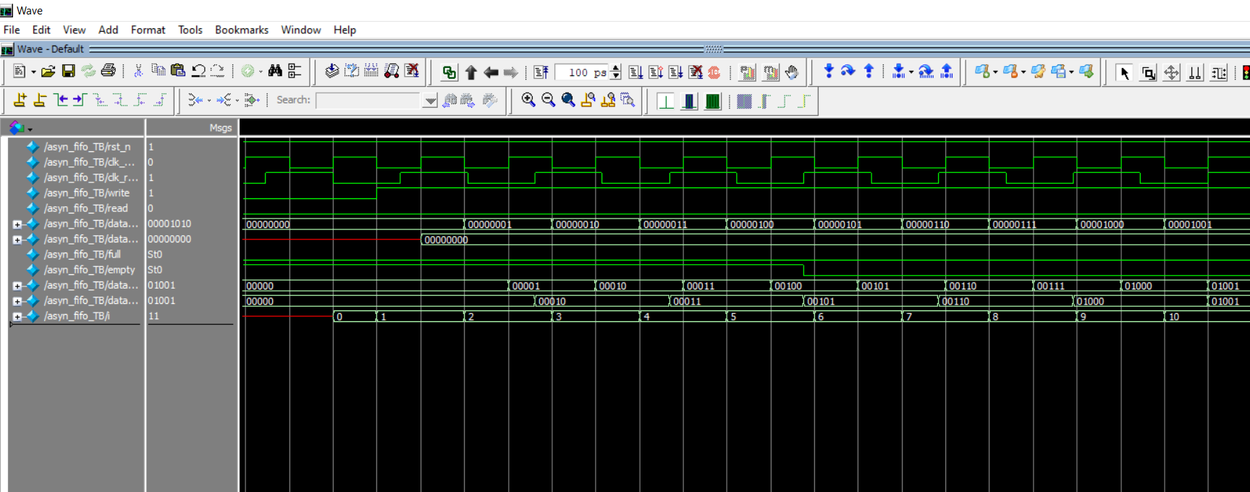
RESULTS

Slide 22
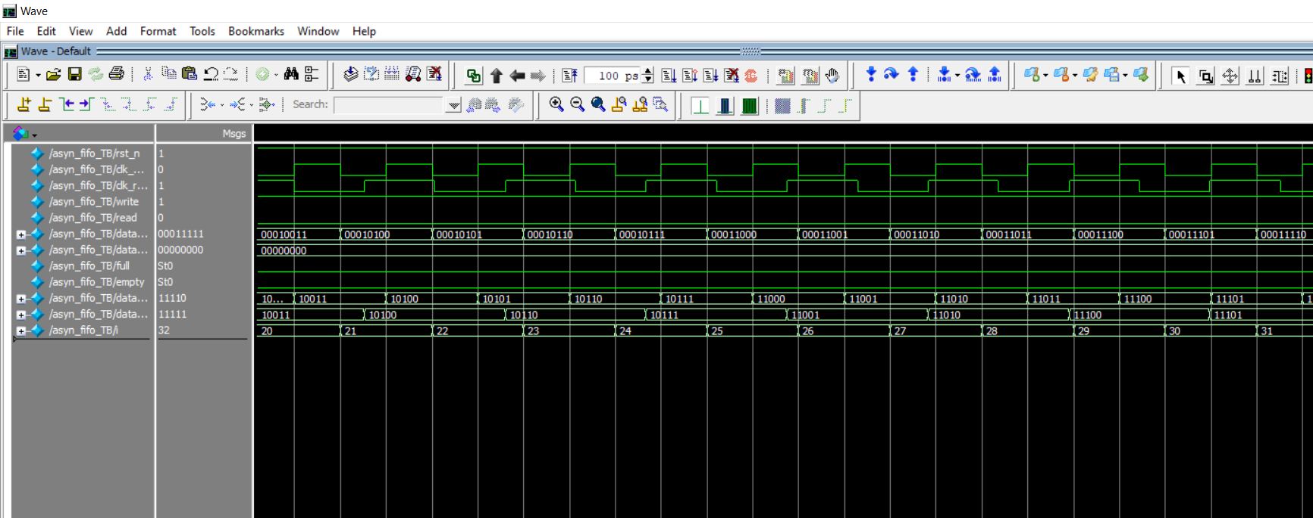
RESULTS

Slide 23
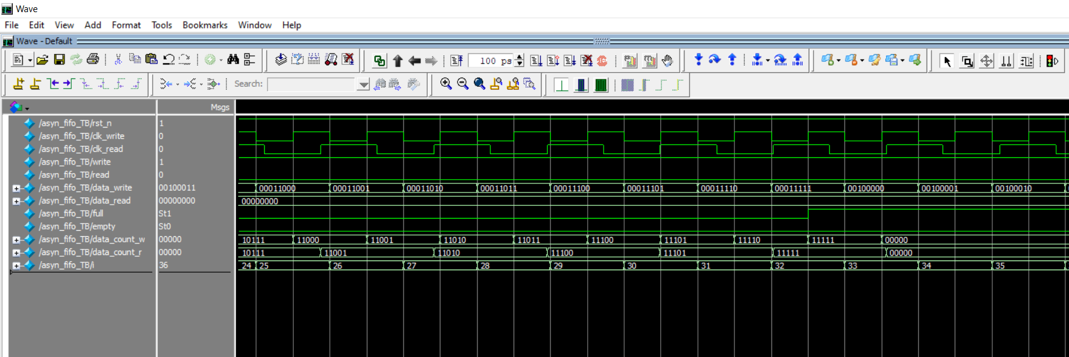
RESULTS

Slide 24
Thank you

